Slide 1


MIAD
Maestría
en Inteligencia Analítica de Datos

Slide 2



MIAD
Positioning BlackBerry Pearl
Maestría
en Inteligencia Analítica de Datos
Sesión sincrónica
Ejercicio semana 4

Slide 3



In September 2006, Research In Motion (RIM) introduced an extension to its best-selling BlackBerry phone, the “BlackBerry Pearl,” with the hope that it could move the original BlackBerry beyond the boardroom and executive suites and into more consumers’ hands. It is the first BlackBerry that comes equipped with the usual features of high-end smartphones, as well as a camera and media playback, yet still provides all the e-mail functions that made Blackberry a hit among executives.
Research In Motion (RIM) launched the BlackBerry wireless, handheld device in 1999. The BlackBerry heralded the launch of smartphones for business users by supporting push e-mail, mobile telephone, text messaging, Internet faxing, Web browsing, and other wireless information services. BlackBerry made headway in the marketplace by first concentrating on e-mail and capturing the “Boardroom” market segment.
Its primary competition came in the form of the Palm Treo, a line of smartphones originally acquired and developed by Handspring. In its early years, the market for smartphones thus was dominated by Palm and RIM.
In summer 2006, Motorola launched its Motorola Q, touting its thin design, and positioned it as an attractive alternative to the BlackBerry.
By fall of 2006, the Blackberry faced competition from a number of smartphones, including several Nokia models (E70, E62, 9300), the Palm Treo, and the Motorola Q, all of which offered multimedia capabilities as well as e-mail connectivity (see Appendix I).

Slide 4
The Strategic Rationale for the Blackberry Pearl
In 2005, world shipments of mobile phones totaled approximately 800 million units, and smartphones represented about 4.7% of these. At the end of 2005, within the smartphone category, Nokia had the highest market share (54.3%), followed by Palm (9.2%), RIM(7%), Motorola (4.6%) and Sony Ericsson (0.6%).
In exploring options to expand its market base beyond the corporate boardroom in the United States, which the Blackberry already dominated, RIM management considered the Blackberry Pearl a strategic opportunity. With the Pearl, RIM expected that it could expand its customer base, combat growing competition from rival phone makers, and retain its dominant position in the growing market for multifunction wireless communication phones.
According to Larry Conlee, Chief Operating Officer of RIM, “It really is our attempt to take BlackBerry out of the boardroom. We listened to the research, we talked to focus groups and our carrier partners, and we asked what was needed to take BlackBerry out of the boardroom and to a broader audience.” Research showed that in 2006, camera phones accounted for approximately 85% of the mobile phone market, and 23% of phones offered mp3 capabilities. A survey of consumers who own a phone with mp3 capabilities indicated that 13% use the mp3 feature on their phone everyday, and 70% use it at least once a week. With the Pearl, RIM expects that BlackBerry will finally catch up with its competition in the multimedia department, with features like a 1.3-megapixel camera, a music and video player, and more stylish looks.

Slide 5
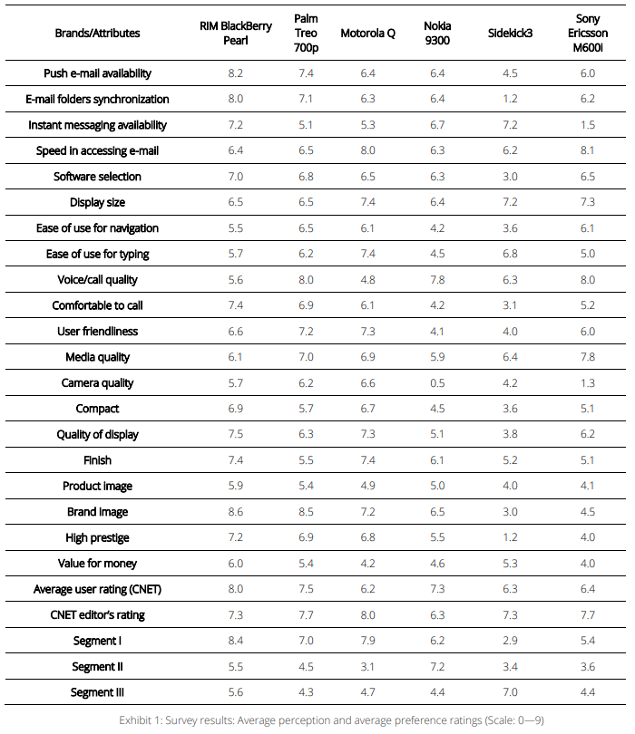
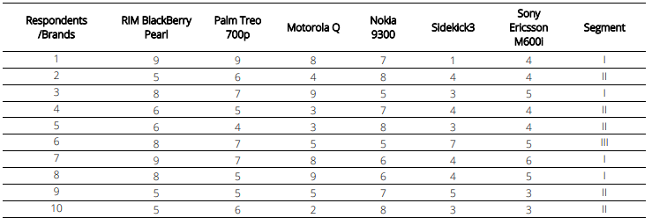


Slide 6
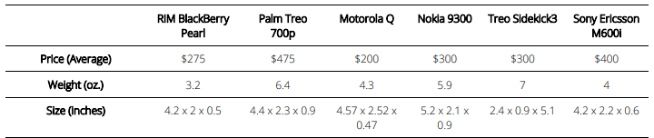
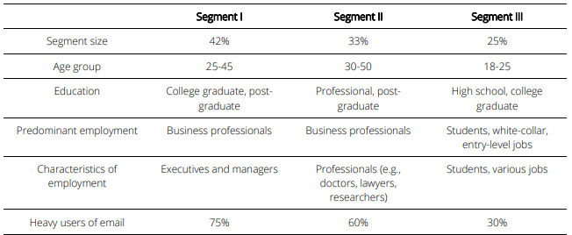
Exhibit 3: smartphone specifications
Exhibit 4: Segment Data

Slide 7
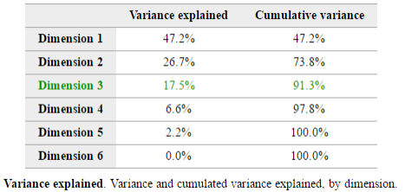
The main decision problem facing RIM is whether to position Blackberry Pearl as a new item for its current customers who are mainly business professionals, or whether to position it in a manner that will bring in new segments (e.g., younger people who are not professionals) to the RIM family.
Question 1 Describe the two (or, if applicable, three) dimensions underlying the perceptual maps that you generated. Based on these maps, how do people perceive the BlackBerry Pearl in the three segments?
R. Looking at the Dimensions portion of the Enginius report, we conclude that two dimensions explain cumulatively 73.8% of variance and three dimensions explain 91.3%.

Slide 8
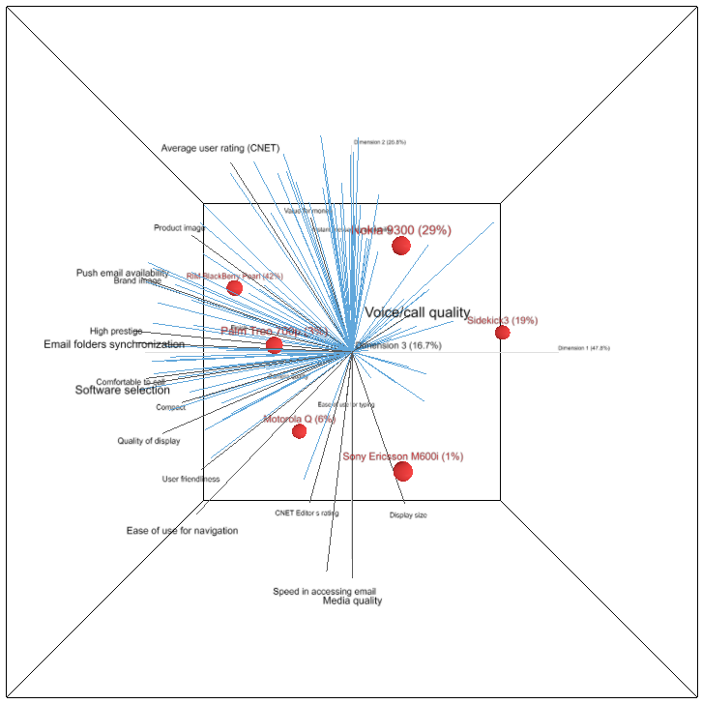
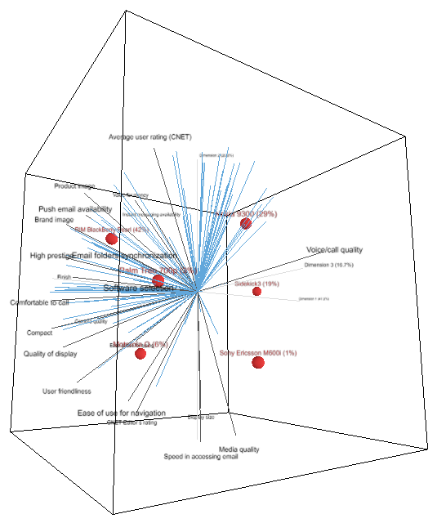

Slide 9
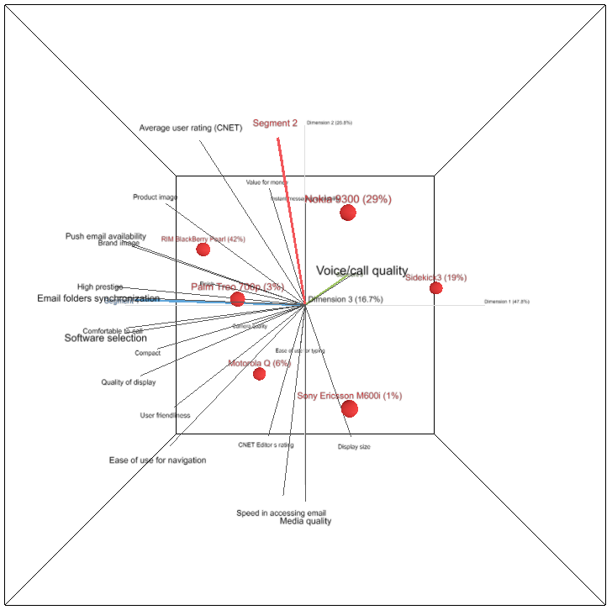
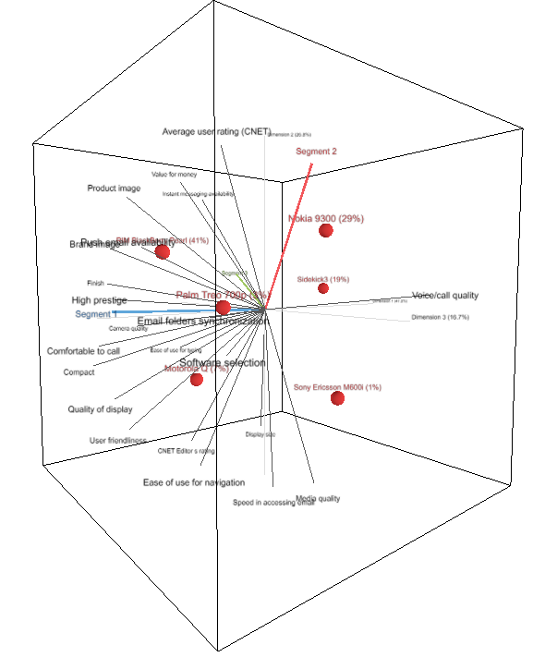

Slide 10
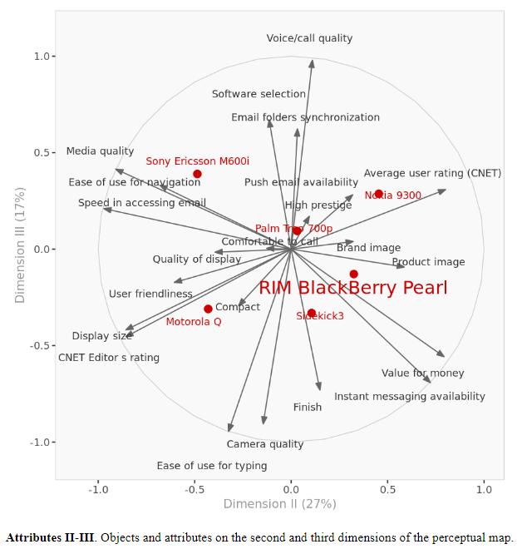
An examination of the 2-D solution suggests that although the overall recovery of information from the data is good (73% of the information in 22 attributes are captured by two dimensions), segment 3 preferences are not as well captured. Perhaps a 3-D map should be considered in this case. Also, the 2-D map does not recover the following attributes (which are particularly relevant for understanding the drivers of Segment III preferences): Voice/Call quality, camera quality, and Ease of use for typing (useful for instant messaging). The importance of the 3rd dimension is best understood by reviewing the Attributes Dimensions II-III chart shown below.

Slide 11
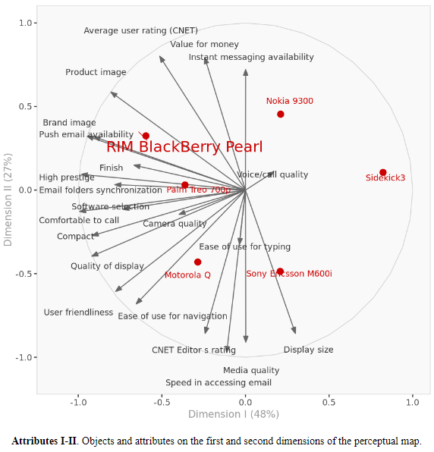
The Attributes Dimensions I-II chart section (below) shows that the BlackBerry Pearl is well positioned with respect its competitors in segments I and II. In segment I, the Pearl should do well compared to its closet competitors, namely, Motorola Q and Palm Treo. In Segment II, Pearl is competitive with Nokia 9300 (it is among the two most preferred products on average in this segment).
The Attribute maps do not lead to easy interpretation. It appears that dimension 1 captures Communication capabilities and Image (47.1% of the variance) and dimension 2 captures Convenience (26.7% of the variance). Associated with the first dimension are attributes such as email push capability, email folder synchronization, software selection, and brand image. Associated with the second dimension are such attributes as instant messaging, ease of use in navigation, and speed of email access. Finally, the third dimension (in a 3-D map) seems to be Media capabilities (17.5% of the variance), and is associated with such attributes as media quality, voice/call quality, and camera quality.

Slide 12
Question 2 Does the Blackberry Pearl appeal to broader segment(s) than business executives, as the company hoped for? Why or why not?
R. Below is a characterization of the three segments.
The positioning maps suggests that it may be possible to extend BlackBerry to segment II (Information enthusiasts), but it would be much harder to extend to segment III (Entertainment enthusiasts). The surprising finding here is that the Pearl appeals so strongly to RIM’s traditional “Boardroom” segment (Segment I). Apparently, this market is not tapped out (or, it might be willing to switch to the Pearl – a potential issue with respect to cannibalization), and it might be possible to extend BlackBerry’s presence in segment I by providing a stylish product that can be used for more than just email and voice calls.
Segment I (Communication enthusiasts): These are likely to be extroverts who love to, or have to, communicate with others. They are often in executive jobs. This segment likes products that have strong brand and product image, high prestige.
Those in segment I are willing to pay for any advanced phone feature that would help them communicate better: particularly in a work setting. They are most likely to prefer BlackBerrys and Palm Treos.

Slide 13
Segment II (Information enthusiasts): These people are a little more introverted and tend to be in information-heavy jobs like research, medicine, and law. They need a smart phone that also helps them manage a lot of information. This segment seeks good value, needs instant messaging capabilities, but does not care that much for display size, media quality, or speed of access to email. There seems to be no ideal product for this segment yet, although Nokia 9300 and the BlackBerry Pearl are the products that seem to appeal well to this segment.
Segment III (Entertainment enthusiasts): People in this segment are likely to be younger (early to late twenties) who want to keep their fun lifestyles even as they enter the workforce. They’ll pay extra for enhanced entertainment features -- music, games, video, fun messaging. This segment is heavily into text messaging. This segment seems to be the one that RIM had in mind to expand into with the Pearl product.

Slide 14
Question 3 Is the Pearl well-positioned to be successful? If not, to which segment(s) would you target and how would you re-position it?
R. The Pearl is very well positioned in Segments I and II, as shown by the Attributes map above. Pearl is located farther ahead of its competitors on most of the preference lines (blue lines) shown on the map.
By examining Pearl’s position in each segment, we can see that Pearl is not as well positioned in Segment III, where it would be tough to beat Sidekick.
The essential tension in the case is whether the Pearl can realistically succeed in Segment III, when it does not have a full keyboard that makes it easier to use for Instant Messaging. One possibility for RIM to expand its presence beyond the “boardroom” is to position Pearl to appeal to entry level business professionals (who may share some characteristics of segment III), and also to freelance executives and consultants who do not have access to enterprise mail servers (these folks are likely to share some characteristics with those of segment I). Another intriguing possibility is to target female professionals – the Pearl’s style and smaller size makes it easier to sell the Pearl to them as compared to selling them traditional Blackberrys.

Slide 15
Question 4 Briefly describe the marketing program you would use to target the chosen segments?
R. Based on our analysis, we conclude that it would be hard for Pearl to make major headway in segment III, which consists of people who are neither executives nor professionals. It would be best for Pearl to leverage its current appeal in the first two segments (Communication Enthusiasts (Executives) and Information Enthusiasts (Professionals). Segment III is heavily into text messaging. Sidekick seems to be well-designed for this segment.
With respect to the marketing program, an example positioning statement to guide marketing efforts could be:
“For executives and professionals who want high performance email and smart phone functionalities in a sleek product, the BlackBerry Pearl is the smartest choice because it is the most stylish product of its kind in the market.”
The most important success factor for the product (especially in the US) would be to partner with a telecom service provider such as Verizon, and T-mobile to promote the product. Other marketing programs to consider include advertising in business magazines travel magazines partnering with airlines and American Express to create awareness for the new product.

Slide 16
Question 5 Summarize the advantages and limitations of the software provided for this application

Slide 17


Marketing
Analytics
MIAD
Maestría
en Inteligencia Analítica de Datos

